Slide 1
AD and LDAP
Active Directory
Lightweight Directory Access Protocol

Slide 2
Access Directory
It Is a common interface for organization and maintaining information related to resources connected to a variety of network directories
Directories tend to contain descriptive,attribute-based information. It support filtering capabilities. Examples address books (attributes such as name,address,phone number etc.)
It is a database that keeps track of all the user accounts and passwords in your organization.It allows you to store user accounts and passwords in location,improving your organization’s security.

Slide 3
LDAP
1. Lightweight Directory Access Protocol (LDAP) is an Internet protocol used to access information directories.
2. A directory service is a distributed database application designed to manage the entries and attributes in a directory.
3. Runs over TCP/IP

Slide 4
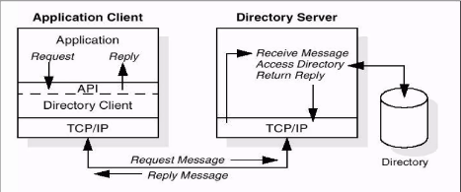
Directory Client/Server Interaction
Clients performing protocol operations against servers
Client sends protocol request to server
Server performs operation on directory
Server returns response (results/errors)

Slide 5
LDAP server and client
How do you make an LDAP server?
There are many options,like Microsoft,OpenLDAP(free),Sun,Netscape,QUALCOMM.If you don’t want to install your own directory service,but just want to use LDAP,instructions for using available LDAP servers,such as four11 and bigfootetc.
How do you make an LDAP Clinet?
There are SDKs in my languages including C,C++,perl,and Java,to help you make an LDAP client.Go get the SDK for your language and use the functions that it provides to connect to and operate on an LDAP server.

Slide 6
LDAP
Directory
A set of objects with similar attributes
Organized in a logical and hierarchical manner
Example:
Telephone directory
Series of names (either of persons or organizations)
Organized alphabetically
Each name has an address and phone number

Slide 7
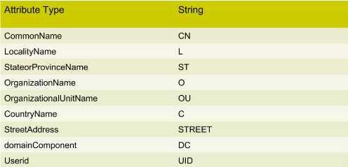
LDAP Naming Examples

Slide 8
LDAP Functions/Operations
Authentication
BIND/UNBIND
ABANDON
Query
Search
Compare entry
Update
Add an entry
Delete an entry (Only Leaf nodes,no aliases)
Modify an entry

Slide 9
Client and Server Interaction
Client establishes sessions with server (BIND)
Hostname/IP and port number
Security
User-id/password based authentication
Client performs operations
Read/Update/Search
SELECT A,B FROM PART OF DIRECTORY
Client ends the session (UNBIND)
Client can ABANDON the session

Slide 10
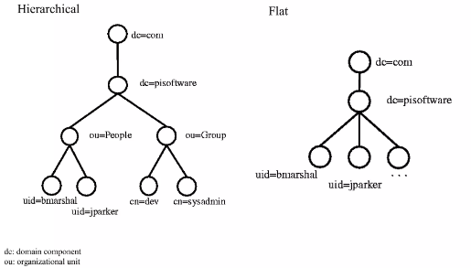
LDAP Data Structure

Slide 11
Directory structure
Protocol accesses LDAP directories
Directory is a tree of directory entries
Entry consists of a set of attributes
An attribute has
a name
an attribute type or attribute description
one or more values
Attributes are defined in a schema
Each entry has a unique identifier:
Distinguished Name (DN)
Consists of its Relative Distinguished Name(RDN) constructed from some attribute(s) in the entry
Followed by the parent entry’s DN
Think of the DN as a full filename and the RDN as a relative filename in a folder

Slide 12
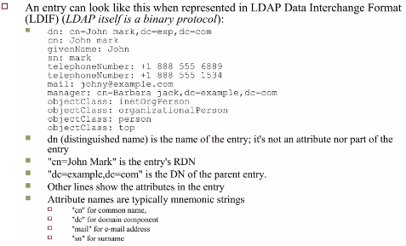
Directory Structure

Slide 13
Directory Structure
A server holds a subtree starting from a specific entry, e.g. “dc=example,dc=com” and its children.
Servers may also hold references to other servers An attempt to access “ou=department,dc=example,dc=com” could return a referral or continuation reference to a server which holds that part of the directory tree.
Client can then contract the other server
Some servers also support chaining Server contacts other server(s) and returns the results to the client

Slide 14
Directory Structure
LDAP rarely defines any ordering: Server may return the values in an attribute the attributes in an entry the entries found by a search operation in any order
Follows from the formal definitions
An entry in defined as a set of attributes
An attribute is a set of values
Sets need not be ordered

Slide 15
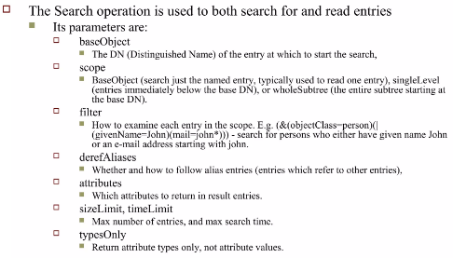
Operations: Search and Compare

Slide 16
Operations: Search and Compare
The server returns Matching entries Maybe continuation references (in any order) Followed by the final result with the result code
The Compare operation Takes a DN an attribute name an attribute value Check if the named entry contain that attribute with that value

Slide 17
Operations: Update operations
Add, Delete, and Modify DN All require the DN of the entry that is to be changed
Modify takes a list of attributes to modify and the modifications to each Add new values,delete the attribute or some values,, or replace the current values with the new ones.
Add operations also can have additional attributes and values for those attributes.

Slide 18
Operations: Extended operations
Extended Operation A generic LDAP operation can be used to define new operations
Examples include the Cancel Password Modify

Slide 19
Usage
Applications
Reasons to choose LDAP for a service Widely supported Data presented in LDAP is available to many clents and libraries LDAP is very general and includes basic security Can support many types of applications
Choosing a few general protocols like LDAP and HTTP for various services Allows focusing on a few protocols Instead of having to maintain and upgrade many specialized protocols
Some tasks LDAP does not handle well: Model a relational database

Slide 20

Thanks You

